Slide 1
CHANNEL EQUALIZATION USING ADAPTIVE ZERO FORCING TECHNIQUE IN RAYLEIGH FADING CHANNEL
-Piyush Srivastava -Vivek Prakash

Slide 2
PAPER OBJECTIVE
Rayleigh Channel represents the multipath fading channel model with no dominant LOS(line of sight) path.
The major challenges in this channel model are fading and interference.
Some equalization techniques are applied to reduce this fading.
But the ISI(inter symbol interference) is main cause of the error at the detection of signal at receiver side.
To remove this ISI and improve the BER(bit error rate) Zero Forcing Equalization technique and other technique like MMSE, ML etc. are implemented.
Main aim was to remove the ISI in the fading channels by using different equalization technique.
Paper’s objective was to implement the Adaptive Zero Forcing technique in a 2X2 MIMO system modulated with the BPSK modulation scheme and plot the BER..
Proposed method for equalization in this paper is Adaptive Zero Forcing Equalization Technique which is implemented by using Least Mean Square Algorithm which shows that if the channel is time variant, the coefficient of least mean square algorithm are changed according to the changes in the channel.
Adaptive Equalization provide efficient BER rates when channel is time variant.

Slide 3
ADDITIONAL WORK
The existing problem statement is enhanced for other two channels: Gaussian and Rician.
AWGN Channel is the channel model in which a linear addition of white noise following Gaussian distribution. It does not account for fading, interference, frequency selectivity.
Rician channel is the channel model in which there is dominant line of sight path between the transmitter and receiver and the other reflected paths are less dominant.
Also, the code is developed to plot the Zero forcing technique to show a more comparative analysis between AZF and ZF.
The eye diagram plot is an added task done to show the change in the output when the techniques are used.

Slide 4
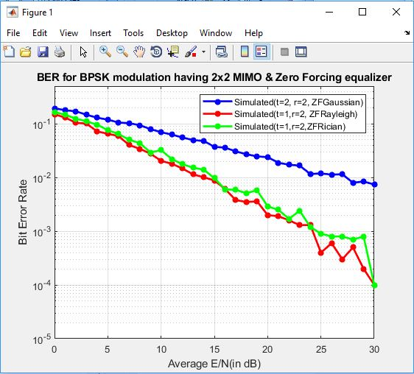
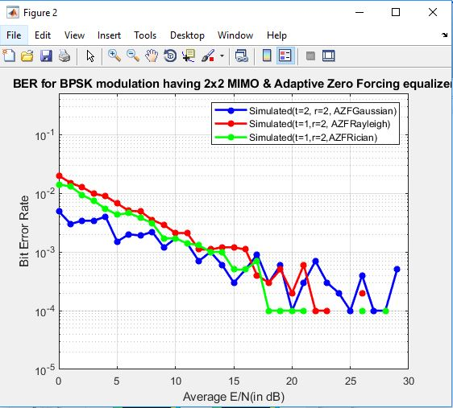
BER COMPARISON FOR ZF AND AZF
The plot shows the comparison between the two plots(ZF and AZF) for all the 3 channels: Gaussian, Rician and Rayleigh.
SNR | BIT ERROR RATE(ZF)
 | Gaussian | Rayleigh | Rician
10 dB | 0.1 | 0.1-0.01 | 0.1-0.01
15 dB | 0.1-0.01 | 0.01-0.001 | 0.01-0.001
SNR | BIT ERROR RATE(AZF)
 | Gaussian | Rayleigh | Rician
10 dB | ~0.001 | ~0.001 | ~0.001
15 dB | 0.001-0.0001 | 0.001-0.0001 | 0.001-0.0001

Slide 5
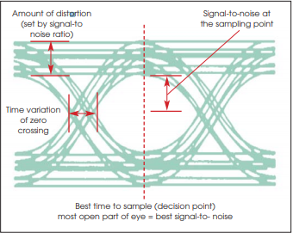
EYE DIAGRAM
The eye diagram is a simple and useful tool for evaluating digital transmission circuitry and systems. It provides instant visual data to verify quality or demonstrate problems. Used in conjunction with other signal integrity measurements, it can help predict performance and identify the source of system impairments.

Slide 6
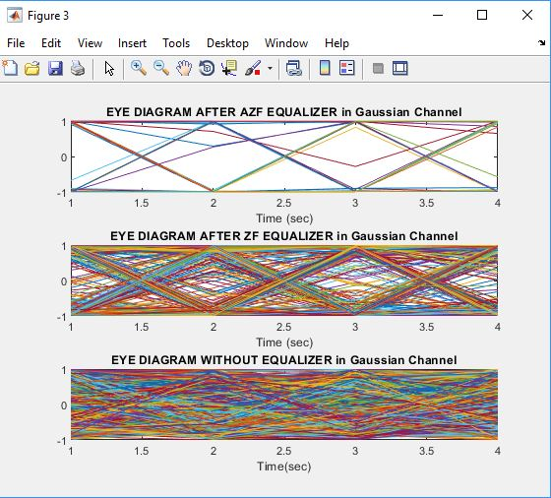
EYE DIAGRAM IN GAUSSIAN CHANNEL

Slide 7
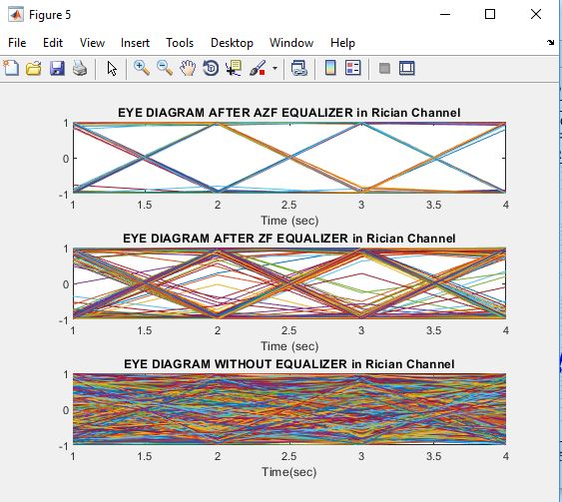
EYE DIAGRAM IN RICIAN CHANNEL

Slide 8
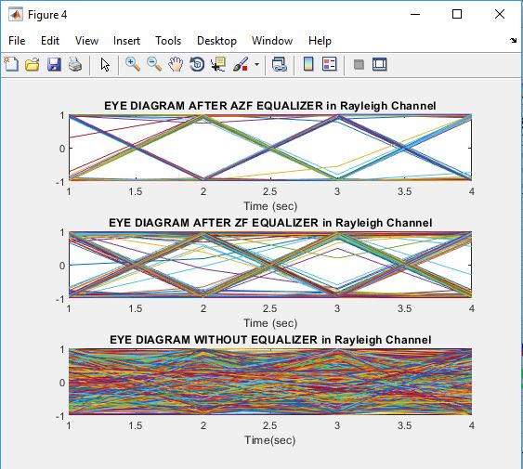
EYE DIAGRAM IN RAYLEIGH CHANNEL

